Slide 1
“THEORY OF AUTOMATA”
Equivalent Regular Expressions

Slide 2
Summary
  RE
  Recursive definition of RE
  defining languages by RE, { x}*, { x}+, {a+b}*
  Language of strings having
  exactly one a
  Language of strings of even length
  Language of strings of odd length
  RE defines unique
  language (as Remark)
  Language of strings having at least one a
  Language of strings having at least one a and one b
  Language of strings starting with aa and ending in bb
  Language of strings starting with and ending in different letters

Slide 3
  Regular expression of EVEN-EVEN language
  Difference between a* + b* and (a+b)*
  Equivalent regular expressions; sum, product and closure of regular expressions; regular languages
  finite languages are regular
  introduction to finite automaton
  definition of FA
  transition table
  transition diagram

Slide 4
Regular Expression
As discussed earlier that Λ* generates K, a, aa, aaa, … and a+ generates a, aa, aaa, aaaa, …,
so the language L₁ = {K, a, aa, aaa, …}
and L₂ = {a, aa, aaa, aaaa, …} can simply be expressed by a* and a+, respectively.
a* and a⁺ are called the regular expressions (RE) for L₁ and L₂ respectively.
Note
a⁺, aa* and a*a generate L₂.

Slide 5
Recursive definition of
Regular Expression(RE)
Step 1 : Every letter of Σ including Λ is a regular expression.
Step 2 : If r₁ and r₂ are regular expressions then
(r₁)
r₁ r₂
r₁ + r₂ and
r₁*
are also regular expressions.
Step 3 : Nothing else is a regular expression.

Slide 6
Method 3 (Regular Expressions)
Consider the language L={K, x, xx, xxx,…} of strings, defined over Σ = {x}.
We can write this language as the Kleene star closure of alphabet G or L= Σ *={x}* .
This language can also be expressed by the regular expression x*.
Similarly the language L={x, xx, xxx,…}, defined over Σ = {x}, can be expressed by the regular expression x⁺.
Now consider another language L, consisting of all possible strings, defined over Σ = {a, b}. This language can
also be expressed by the regular expression (a + b)*.
Now consider another language L, of strings having exactly one a, defined over Σ = {a, b}, then it’s regular expression may be b*ab*.
Now consider another language L, of even length, defined over Σ = {a, b}, then it’s regular expression may be ((a+b)(a+b))*.
Now consider another language L, of odd length, defined over Σ = {a, b}, then it’s regular expression may be (a+b)((a+b)(a+b))* or ((a+b)(a+b))*(a+b).

Slide 7
Method 3 (Regular Expressions)
Remark
It may be noted that a language may be expressed by more than one regular expression, while given a regular expression there exist a unique language generated by that regular expression.
Example
Consider the language, defined over
Σ = {a , b} of words having at least one a, may be expressed by a regular expression (a+b)*a(a+b)*.
Consider the language, defined over Σ = {a, b} of words having at least one a and one b, may be expressed by a regular expression (a+b)*a(a+b)*b(a+b)*+ (a+b)*b(a+b)*a(a+b)*.
Consider the language, defined over Σ ={a, b}, of words starting with double a and ending in double b then its regular expression may be aa(a+b)*bb
Consider the language, defined over Σ ={a, b} of words starting with a and ending in b OR starting with b and ending in a, then its regular expression may be a(a+b)*b+b(a+b)*a

Slide 8
The Language EVEN-EVEN
Language of strings, defined over Σ ={a, b} having even number of a’s and even number of b’s. i.e.
EVEN-EVEN = {Λ, aa, bb, aaaa,aabb,abab, abba, baab, baba, bbaa, bbbb,…}, its regular expression can be written a (aa+bb+(ab+ba)(aa+bb)*(ab+ba))*
Note
It is important to be clear about the difference of the following regular expressions
r¹ = a*+b*
r² = (a+b)*
Here r₁ does not generate any string of concatenation of a and b, while r₂ generates such strings.

Slide 9
Equivalent Regular Expressions
Definition
Two regular expressions are said to be equivalent if they generate the same language.
Example
Consider the following regular expressions
r₁ = (a + b)* (aa + bb)
r₂ = (a + b)*aa + ( a + b)*bb then both regular expressions define the language of strings ending in aa or bb.
Note
If r₁ = (aa + bb) and r₂ = ( a + b) then
r₁+r₂ = (aa + bb) + (a + b)
r₁r₂ = (aa + bb) (a + b) = (aaa + aab + bba + bbb)
(r₁)* = (aa + bb)*

Slide 10
Regular Languages
Definition
The language generated by any regular expression is called a regular language.
It is to be noted that if r₁, r₂ are regular expressions, corresponding to the languages L₁ and L₂
then the languages generated by r₁+ r₂, r₁r₂( or r₂r₁) and
r₁*( or r₂*) are also regular languages.
Note
It is to be noted that if L₁ and L₂ are expressed by r₁ and r₂, respectively then the language expressed by
r₁+ r₂, is the language L₁ + L₂ or L₁ U L₂
r₁r₂, is the language L₁L₂, of strings obtained by prefixing every string of L₁ with every string of L₂
r₁*, is the language L₁*, of strings obtained by concatenating the strings of L, including the null string.

Slide 11
Regular Languages
Example
  If r₁ = (aa+bb) and r₂ = (a+b) then the language of strings generated by r₁+r₂, is also a regular language, expressed by (aa+bb) + (a+b)
  If r₁ = (aa+bb) and r₂ = (a+b) then the language of strings generated by r₁r₂, is also a regular language, expressed by (aa+bb)(a+b)
  If r = (aa+bb) then the language of strings generated by r*, is also a regular language, expressed by (aa+bb)*

Slide 12
All finite languages are regular
Example
Consider the language L, defined over Σ = {a,b}, of strings of length 2, starting with a, then L = {aa, ab}, may be expressed by the regular expression aa+ab. Hence L, by definition, is a regular language.
Note
It may be noted that if a language contains even thousand words, its RE may be expressed, placing ‘ + ’ between all the words.
Here the special structure of RE is not important.
Consider the language L = {aaa, aab, aba, abb, baa, bab, bba, bbb}, that may be expressed by a RE
aaa+aab+aba+abb+baa+bab+bba+bbb, which is equivalent to (a+b)(a+b)(a+b).

Slide 13
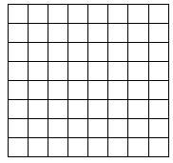
Introduction to Finite Automaton
Consider the following game board that contains 64 boxes

Slide 14
There are some pieces of paper. Some are of white colour while others are of black colour. The number of pieces of paper are 64 or less. The possible arrangements under which these pieces of paper can be placed in the boxes, are finite. To start the game, one of the arrangements is supposed to be initial arrangement. There is a pair of dice that can generate the numbers 2,3,4,…12 . For each number generated, a unique arrangement is associated among the possible arrangements.
It shows that the total number of transition rules of arrangement are finite. One and more arrangements can be
supposed to be the winning arrangement. It can be observed that the winning of the game depends on the
sequence in which the numbers are generated. This structure of game can be considered to be a finite automaton.

Slide 15
Method 4 (Finite Automaton)
Definition
A Finite automaton (FA), is a collection of the followings
  Finite number of states, having one initial and some (maybe none) final states.
  Finite set of input letters (Σ) from which input strings are formed.
  Finite set of transitions i.e. for each state and for each input letter there is a transition showing how to move from one state to another.

Slide 16
Method 4 (Finite Automaton)
Example
G = {a,b}
States: x, y, z where x is an initial state and z is final state.
Transitions:
At state x reading a, go to state z
At state x reading b, go to state y
At state y reading a, b go to state y
At state z reading a, b go to state z

Slide 17
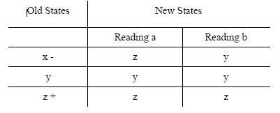
These transitions can be expressed by the following table called transition table

Slide 18
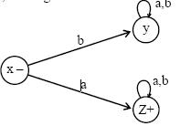
Note
It may be noted that the information of an FA, given in the previous table, can also be depicted by the following diagram, called the transition diagram, of the given FA
Remark
The above transition diagram is an FA accepting the language of strings, defined over Σ ={a, b},starting with a.
It may be noted that this language may be expressed by the regular expression a(a + b)*

Slide 19
Different notations of transition diagrams, languages of strings of even length, Odd length, starting with b, ending in a, beginning with b, not beginning with b, beginning and ending in same letters
Note
It may be noted that to indicate the initial state, an arrow head can also be placed before that state and that the final state with double circle, as shown below. It is also to be noted that while expressing an FA by its transition diagram, the labels of states are not necessary.

Slide 20
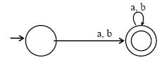
Example
G = {a,b}
States: x, y, where x is both initial and final state.
Transitions:
At state x reading a or b go to state y.
At state y reading a or b go to state x.

Slide 21
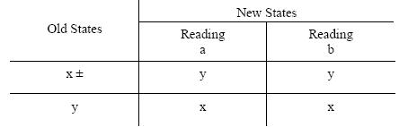
These transitions can be expressed by the following transition table
It may be noted that the above transition table may be depicted by the following transition diagram.

Slide 22

The above transition diagram is an FA accepting the language of strings, defined over Σ={a, b} of even length. It may be noted that this language may be expressed by the regular expression ((a+ b) (a + b))*

Slide 23
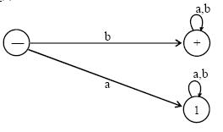
Example:
Consider the language L of strings, defined over Σ={a, b}, starting with b. The language L may be expressed by RE b(a + b)* , may be accepted by the following FA

Slide 24
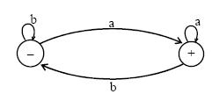
Example
Consider the language L of strings, defined over Σ={a, b}, ending in a. The language L may be expressed by RE (a+b)*a.
This language may be accepted by the FA shown aside

Slide 25
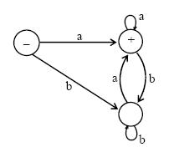
There may be another FA corresponding to the given language, as shown aside

Slide 26
Note
It may be noted that corresponding to a given language there may be more than one FA accepting that language, but for a given FA there is a unique language accepted by that FA.
It is also to be noted that given the languages L₁ and L₂ ,
where L₁ = The language of strings, defined over Σ ={a, b}, beginning with a. L₂ = The language of strings, defined over Σ={a, b}, not beginning with b The does not belong to L₁ while it does belong to L₂ .
This fact may be depicted by the corresponding transition diagrams of L₁ and L₂.

Slide 27
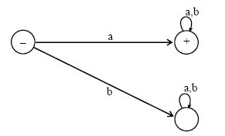
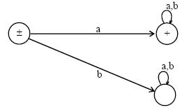
FA1 Corresponding to L₁
The language L₁ may be expressed by the regular expression a(a + b)*
FA2 Corresponding to L₂
The language L₂ may be expressed by the regular expression a(a + b)* +Λ

Slide 28
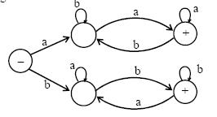
Example
Consider the Language L of Strings of length two or more, defined over Σ= {a, b}, beginning with and ending in same letters.
The language L may be expressed by the following regular expression a(a + b)*a + b(a + b)*b It is to be noted that if the condition on the length of string is not imposed in the above language then the strings a and b will then belong to the language.
This language L may be accepted by the FA as shown aside

Slide 29
LINK
chadsalinas.wordpress.com/2007/06/27/equivalent-regular-expressions
swtch.com/~rsc/regexp/regexp1.html

